Slide 1
Chapter 3 Pricing Data Smartly
Why do AT&T and Verizon Wireless charge me $10 a GB?

Slide 2
Our Cell Phone Bill
Data charges make up a significant part of our cell phone bills
The data plans in our cellular contracts dictate how much we will pay for the bytes (data) we consume
How do cellular providers set these price points?
Usage-based vs. flat-rate pricing schemes
how usage-based pricing schemes can send better feedback signals than flat-rate, “buffet” schemes, leading to better sharing of networks
Pricing can be a powerful tool to manage networks

Slide 3
Usage-based vs. Flat-rate Pricing
Flat-rate pricing
buffet: all you can eat with fixed price
pros and cons?
good if you are hungry
unfair – light users subsidize heavy users’ lifestyle
can a restaurant keep offering buffet forever without raising $?
tragedy of the commons
Usage-based pricing
use more, pay more
pros and cons?
produce less “waste” and match “cost”
fairer

Slide 4
Pricing of Data Plans
Data plans include all Internet applications – texting, surfing, streaming, video conferencing, etc.
How utility bills (electricity, water, gas, etc.) are handled?
based on quantity of service consumed – use more, pay more
Wireless cellular capacity is expensive to provide and difficult to crank up

Slide 5
Flat-Rate Pricing
Flat-rate price: one that doesn’t depend on how much you actually consume
buffet: all you can eat with fixed price
Pros and cons?
unfair – but good if you are hungry
not sustainable
Make sense when usage of mobile data was low in comparison to voice/text (in the old days)
Something happened in 2007 and changed everything!!
introduction of iPhone: demand for data rises sharply (> 50x) as (1) smartphones can surf the web, stream music & videos, and support many data-intensive applications and (2) # of people using smartphones

Slide 6
Growth of Mobile Data
Gigabytes (GB) = billions of bytes = 10⁹ bytes
Exabyte (EB) = one billion GB = 10¹⁸ bytes
~50% increase per year
Buffets have finite amount of food
Networks only have a limited capacities to support flow of data to and from devices
Make up of data in 2014

Slide 7
Distribution of Capacity Demand
How light, average, and heaver users are distributed?
Heavy users at tail dictate ISP’s cost structure
Tail has always been long, and is getting longer and longer
of users

Slide 8
Tragedy of the Commons
Analogy (in economics) to flat-rate pricing
Described by Garrett Hardin, Science, vol. 162, 1968
Herdsmen sharing pasture to feed livestock
How to maximize individual profits?
Herdsmen selfishly maximize personal gain by adding cattle
Every herdsman thinks the same
Results
overgrazing - too many cattle cause pasture to deplete
tragedy shared by all herdsmen
Without proper “signal,” herdsmen collectively drive pasture to ruin (tragedy)

Slide 9
Tragedy of Flat Rate
To maximize personal gain, each herdsman keeps adding cattle
Under flat-rate data plan, users keep consuming more
no additional cost is incurred each time consumer draws from network
cost of congestion is shared by all users
eventually network buckles under too much collective demand from everyone
negative network effect
the more users chasing their own self-interests, the more effect this has on the whole, and eventually an undesirable scenario is reached
Efficient price signal - with higher price comes lower demand to avoid tragedy

Slide 10
Jobs’ Inequality of Capacity
Since 2007, growth in demand was beginning to outpace growth in the amount of supply that could be provisioned with each additional dollar spent on increasing network capacity
Gap keeps widening in the years since
user demand and innovations in data applications proceed faster than supply side (capacity) could keep up with

Slide 11
Jobs’ Inequality of Capacity
No technology can increase its cost-effectiveness aggressively each year forever
Need a way of regulating demand to keep it in line with capacity, so that network could be shared more effectively
How?
Usage-based pricing – use more, pay more

Slide 12
Use More, Pay More
Usage-based pricing scheme
customers are charged based on how much data they consume (per month)
send different pricing signals to consumers
incur a cost for each bucket of GB consumed

Slide 13
Internalize Negative Externality
Power Control
Each phone imposes negative externality on others, by interfering with them
while benefiting itself, a phone does some damage to rest of network
Message passing between BS and phone to correct for deviations: negative feedback for power control
transmitters internalize its negative externality (i.e., pay for interference they cause) by controlling power to make up for their added interference to system
Data Pricing
As a form of negative feedback (signal) to consumer
cellular’s measured SIR as negative feedback for power control
WiFi’s “lack of” ACK as negative feedback for MAC
Network regulates user’s demand based on available capacity by feeding back usage-based pricing
Each user is asked to internalize her negative externality (added congestion) on network by paying for amount consumed

Slide 14
From Flat-rate to Usage-based
When will it happen?
usage surges and demand climbs faster than supply
e.g., more phones and more capable phones
Usage-based pricing helps carriers catch up with cost of supporting rising demand
Long tail getting longer
demand of heaviest users increases the most
heavy users are dominant factor in how much it costs ISP/carrier to manage network
As tail gets longer, (cost – revenue) increases, when using flat-rate pricing

Slide 15
Usage-based Pricing Plan
Verizon 2016
“Baseline” flat rate
Above baseline, usage-based pricing kicks in
Overall charge is based on total monthly usage (how much used, not when, where, or how it is used)

Slide 16
Economics of Happiness
There is a free pie of pizza and you are hungry
First piece
taste great
Second piece
taste quite good
Third piece
taste good, but not as hungry anymore, so it’s not doing quite as much “good” as the first or second did
Eventually, indifferent to eating another slice. Since it’s free, you might go for it since it tastes good, but you would not be willing to pay for another at this point

Slide 17
Quantifying Happiness via Utility
Notion of utility models how a person’s “happiness” changes with amount of resource allocated to her
What will the “curve” look like?
Two common characteristics of utility curve
increasing → higher quantity, higher utility
diminishing marginal returns
(e.g., pizza, data)

Slide 18
Net Utility (Payoff)
Q: how to quantify utility (happiness)?
A: one way is to observe how consumers behave with respect to resource in question
Whenever making a purchase, make net utility as high as possible
Net utility = payoff = [satisfaction − price paid]
When customer purchases an amount of a resource at a specific unit price (i.e., $10/GB),
Quantity a user purchases depends on price charged
a relationship known as demand (desire for resources at different prices)
net utility = payoff = utility – (unit price X quantity)

Slide 19
Demand Function
Demand function capture the volume of demand as a function of price offered
observed via consumer behavior
e.g., higher price, lower demand
Demand curve: depicts relationship between price and demand
a decreasing (never increasing) function of price
can take different shapes
e.g., linear demand
demand
price

Slide 20
Demand Curve
Assume seller fixed a usage-based (unit) price,
from offered (unit) price, obtain user’s demand (quantity purchased) on curve
(total) price paid = ?
unit price x quantity (area B)
user’s utility = ?
B + A (why? – next slide)
net utility = ?
(B + A) - B = A

Slide 21
Compute Utility from Demand
Utility function (U) captures “how happy” a user would be if a certain quantity of resources (x) is allocated - [U(x)]
net utility = utility – (unit price) X (quantity)
net utility = U(x) – px
How to maximize net utility?
pick x that maximizes the above
Assume U(x) is concave, take derivative with respect to x and let it be 0
Uʹ(x) = p
Since Uʹ is invertible, x = Uʹ⁻¹(p)
let x = D(p) → demand function
utility function determines corresponding demand function
Since Uʹ = D⁻¹, utility to user is the area (integration) under the inverse demand curve: U = ∫D⁻¹
(p)

Slide 22
Consumption under Usage-based Pricing
Why is it that the quantity a user consumes will be fixed to demand curve in the first place?
Or why would a person not be incentivized to consume more, or to purchase less?
Answer: Under usage-based pricing, the quantity at the unit price is the one that maximizes user’s net utility
Consider what happens when we decrease or increase quantity consumed from demand curve…..

Slide 23
Consumption under Usage-based Pricing
net utility = utility – (unit price x quantity)
“Price charged” decreases by B1, and utility decreases by A1+B1
→ net utility decreases by A1
net utility = utility – cost
→ (utility – B1 – A1) – (cost – B1)
= utility – cost – A1
Lessened utility outweighs lessened cost

Slide 24
Consumption under Usage-based Pricing
net utility = utility – (unit price x quantity)
While utility rises by A2, price charged rises by A2+B2
→ net utility decreases by B2
net utility = utility – cost
→ (utility + A2) – (cost + A2 + B2)
= utility – cost – B2
Added cost outweighs added utility

Slide 25
Consumption under Usage-based Pricing
This is why, under a usage-based scheme, it is always in the consumer’s best interest to base consumption on demand curve
Charging a unit price for data gives ISP ability to regulate user demand for data consumption over a mobile network
If ISP sets unit price based on cost it incurs to operate and maintain network, this will send an efficient feedback signal to consumers: one that forces (incentivizes) them to internalize the negative externality they are imposing on the network from their consumption
ISP cost → unit price → base usage on demand curve

Slide 26
Consumption under Flat-Rate
Does flat-rate pricing also entice users to stay on demand curve?
Flat-rate pricing charges a single, fixed amount irrespective of amount consumed
Under this scheme, then, it’s in the best interest of a customer to grab as much as possible, until there is no more utility to be gained
The user should “stray” from demand curve
Think about it: if you pay $20 each month for your data plan, what would dissuade you from streaming 100 videos as opposed to 10?
Clearly not money!!!

Slide 27
Flat-Rate Pricing Create Waste
User consumes to top of demand curve as if price were 0
User surplus = [utility achieved by customer] – [cost incurred by provider]
= (A+B+C) – (B+C+D) = A – D
Area D = added cost not counteracted by any gain in utility
Waste!
Don’t take more than your demand calls for
Flat rate charge

Slide 28
Flat-Rate Pricing Favors Heavy Users
Flat rate charge
Under flat-rate, to recover capacity cost of ISP, users are charged based on consumption amount of average user
Light user: U1 – R < 0 (negative surplus)
Heavy user: U2 – R > 0
Light users subsidize heavy user’s lifestyle (utility)

Slide 29
Net Utility vs. User Surplus
net utility = utility - unit price x quantity
best used for usage-based pricing
user surplus = utility - cost incurred by provider
better for flat-rate pricing (as there is no notion of unit price)
ISP has to recover its cost
Flat rate charge

Slide 30
Service Upgrade
Shifts demand curve to the right
as there will be higher demand if price remains the same while service is enhanced
Increase cost-recovering flat-rate price
(U_{l} – C_{l}) ? (U_{h} – C_{h})
Answer: >
What does it imply?
Flat-rate pricing discourages adoption of higher-quality services by light users (light user sticks to poor service)

Slide 31
Smart Data Pricing (SDP)
“There is no such thing as a free lunch”
it is impossible to get something for nothing
cost of building and operating a network must be paid by someone
3 dimensions of SDP
how to charge
whom to charge to
what to charge for

Slide 32
How to Charge?
How should an ISP charge?
reward customers for unused data quotas or allow them to trade
congestion-dependent pricing
time-dependent (charging more at times of day with higher demands)
location-dependent (charging less at locations with lower demands)
regulates network demand and utilization at a finer scale

Slide 33
Whom to Charge to?
To whom should an ISP charge?
In addition to charging direct consumers of mobile data, network operators may also charge others on food chain
content provider that are getting hits on their sites
sponsored content scheme: content providers split cost of network with end users
use airport WiFi for a fee or relatively cheap price after watching some advertisement
split billing: bring your own device to work – employer pays part of mobile data
zero-ratig or toll-free data: charged less or not at all for data consumed for specific applications

Slide 34
What to Charge for?
What should an ISP charge for?
data usage
end user experience (QoS)
Internet transaction

Slide 35
Smart Data Pricing (SDP)
Considering
how to charge
whom to charge to
what to charge for
all together, SDP can achieve more effective pricing signals to induce efficient sharing

Slide 36
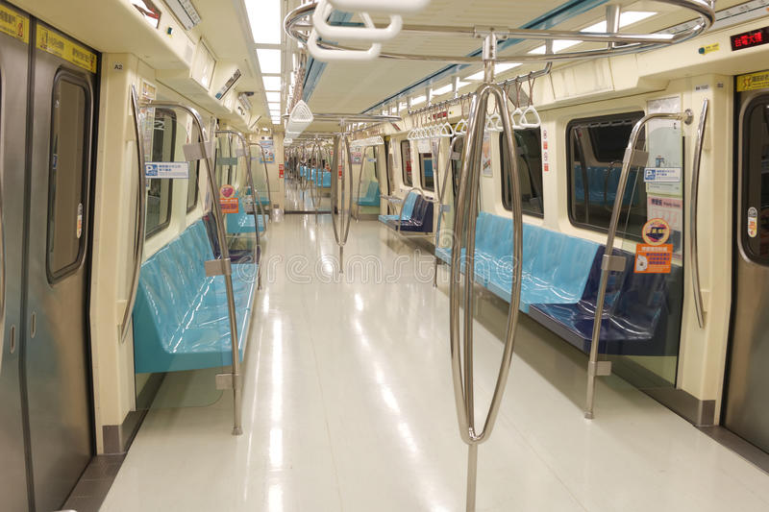


Paris Metro Pricing
$$
$
How can you charge differently for the exact same service?
No longer the same service as soon as consumers react to the different prices

Slide 37
Paris Metro Pricing
Creates service differentiation through price differentiation
Utility depends on utilization
lower price increases demand and utilization, thus reducing utility for those in that service tier
higher price reduces demand and utilization, thus increasing utility for those in that service tier

Slide 38
Two-Sided Pricing
Whom to charge to?
Price of connectivity is shared between content providers (CPs) and end users (EUs)
CP may gain from two-sided pricing if subsidizing connectivity to EUs translates into net revenue gain through larger amount of consumption

